Slide 1
Real Estate Market Analysis
By: Mahmoud Amr Ahmed Sameh Youssef Shaban Mohamed Essam

Slide 2
Agenda
Introduction
Database Creation
Exploring and Cleaning Data Using SQL
ETL Using SSIS Package
DWH Design
Cloud Data Ingestion
Cloud Data Processing
Dashboard
Conclusion

Slide 3
Introduction
Egypt’s real estate market is one of the largest and most dynamic in the MENA region, driven by a growing population and urbanization.
Population growth, government mega-projects (like the New Administrative Capital), and expanding middle-class housing needs fuel demand.
Includes residential, commercial, industrial, and land properties.
Real estate in Egypt is a favored investment due to its perceived safety, especially during economic volatility, offering opportunities for both local and foreign investors.

Slide 4
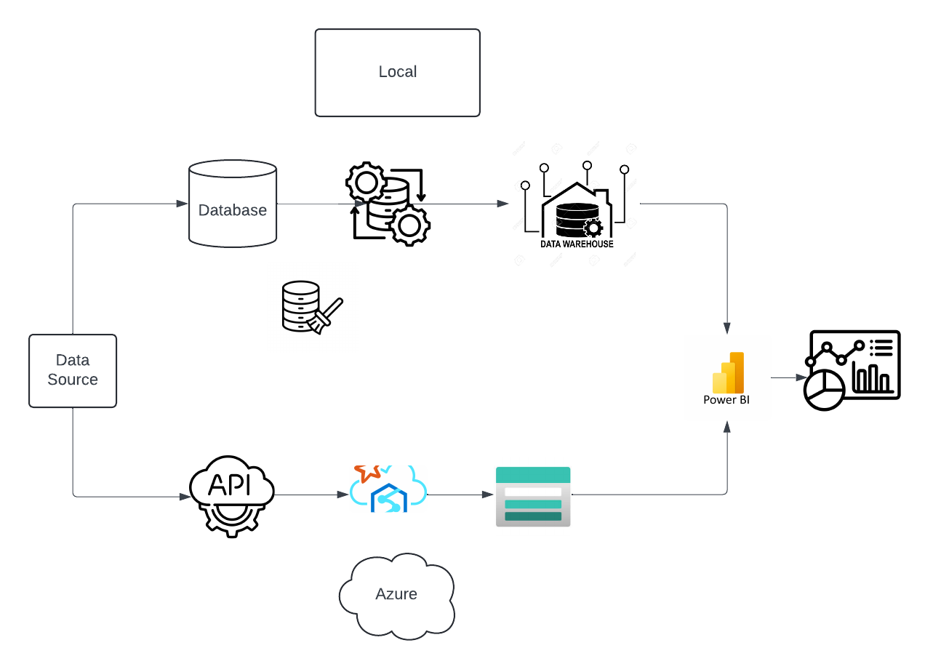

Slide 5
In this project, we developed a comprehensive data pipeline to analyze real estate market trends.
The workflow began with the creation of a structured database to store and manage property and client data.
We applied rigorous data cleaning techniques using SQL to ensure data accuracy and consistency.
Next, we implemented data transformation processes using Spark Pool notebooks and Azure Data Factory data flows.
These tools allowed us to efficiently extract raw data from a GitHub repository, transform it, and load it into an Azure Storage Account.
This storage account is seamlessly connected to Power BI, where we built interactive dashboards to visualize key insights.

Slide 6
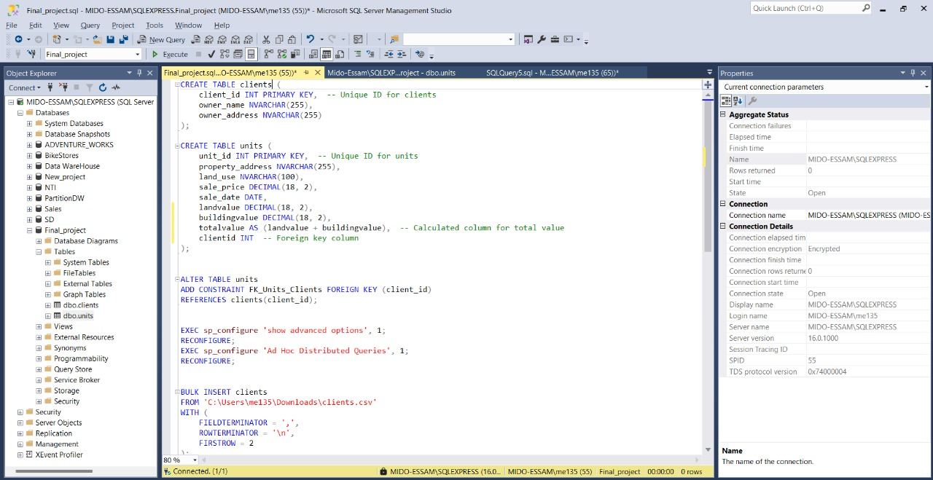
Database Creation

Slide 7
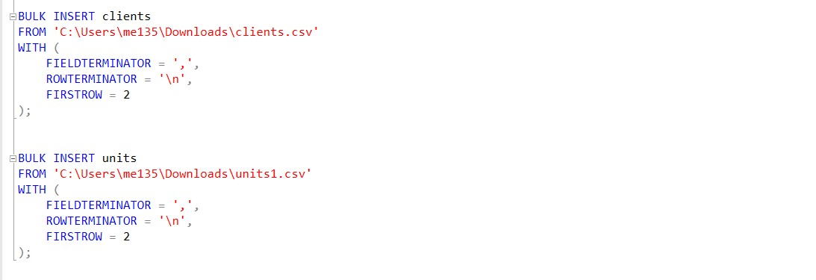
Exploring and Cleaning Data Using SQL

Slide 8
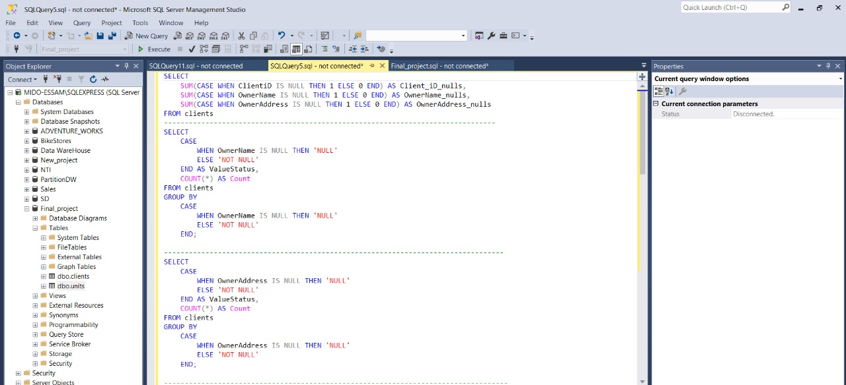

Slide 9
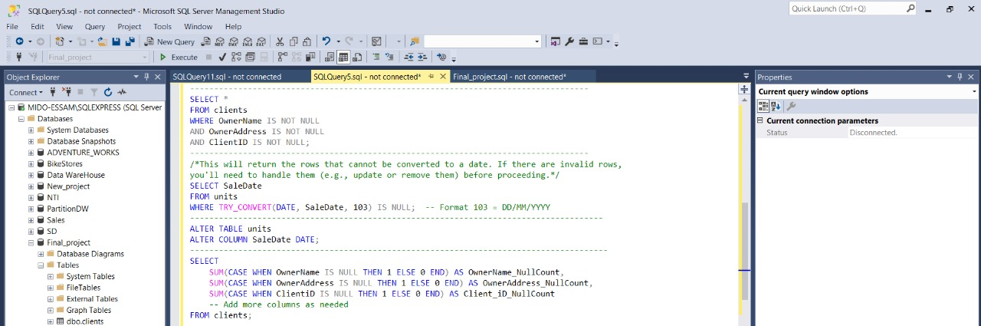

Slide 10
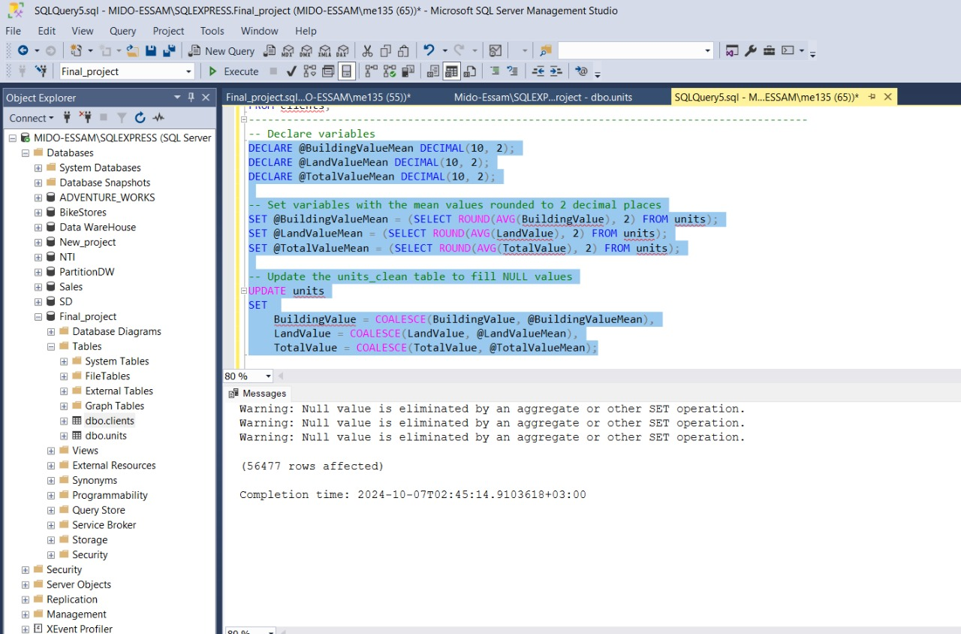

Slide 11
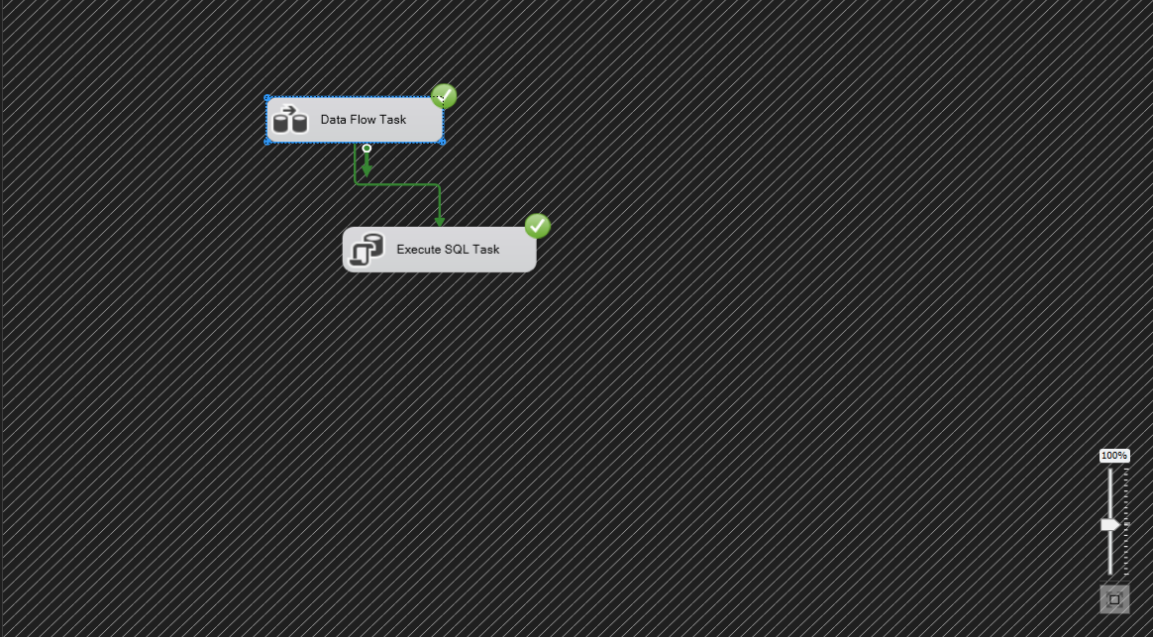
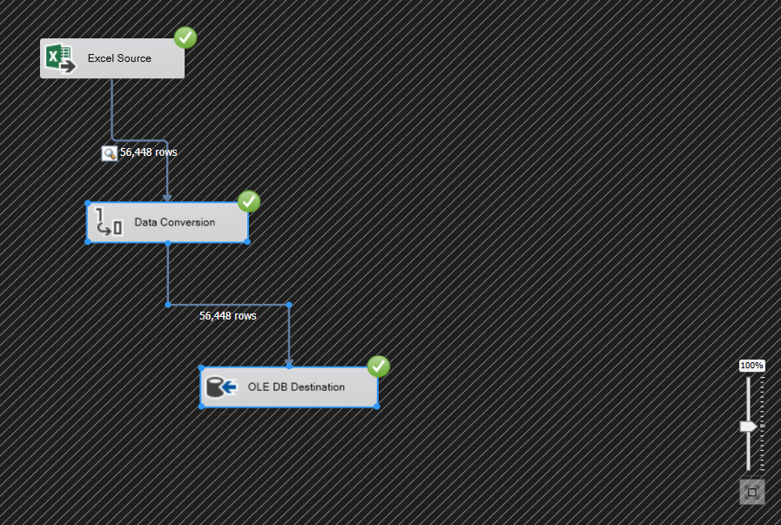
ETL Using SSIS Package

Slide 12
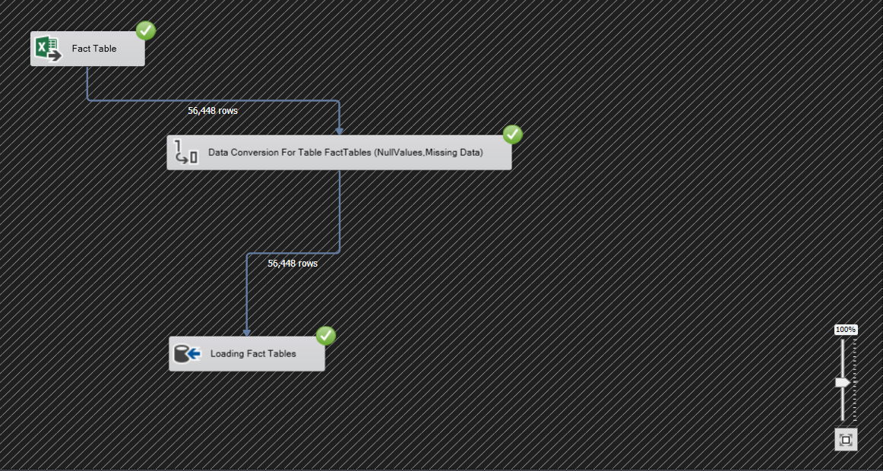
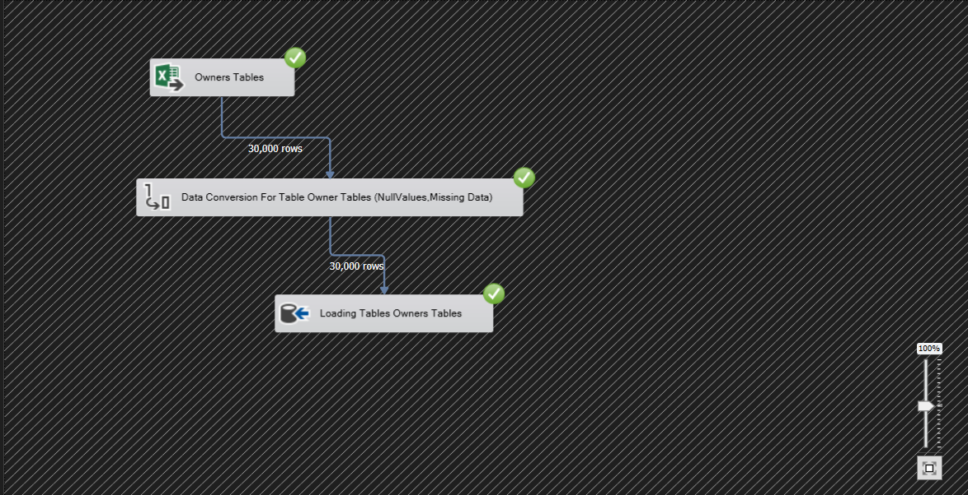
ETL Using SSIS Package

Slide 13
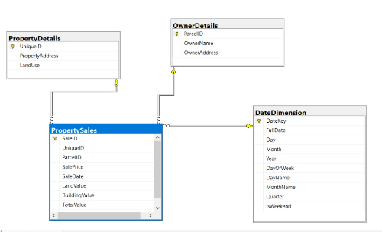
DWH Design

Slide 14
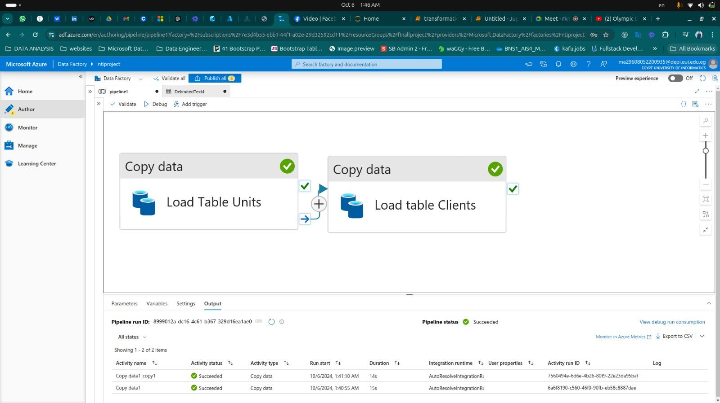
Cloud Data Ingestion

Slide 15
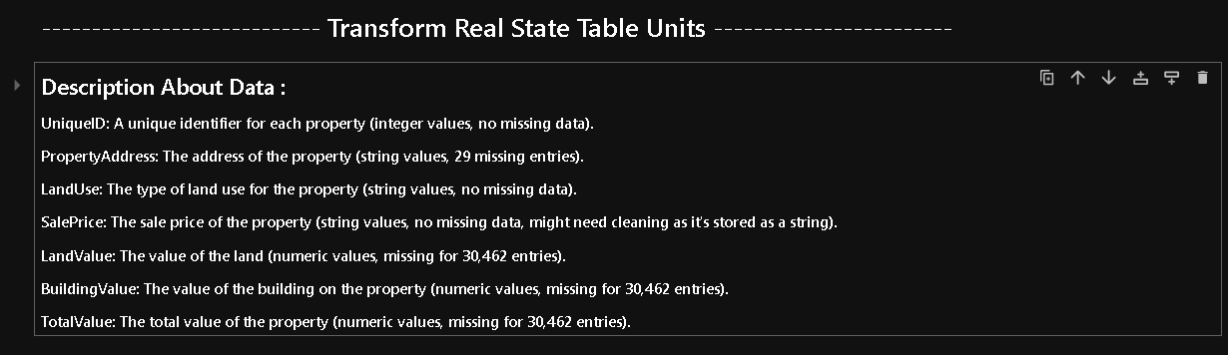
Cloud Data Processing(Python)

Slide 16
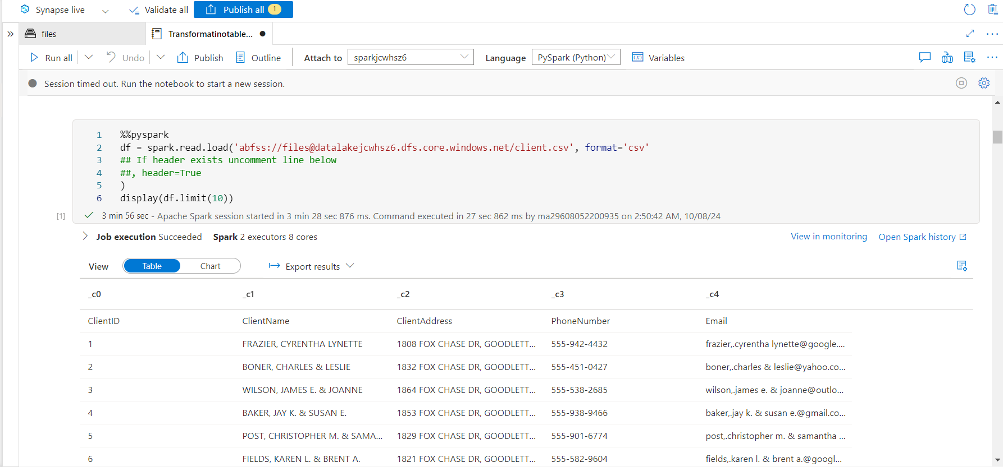
Cloud Data Processing(pyspark)

Slide 17
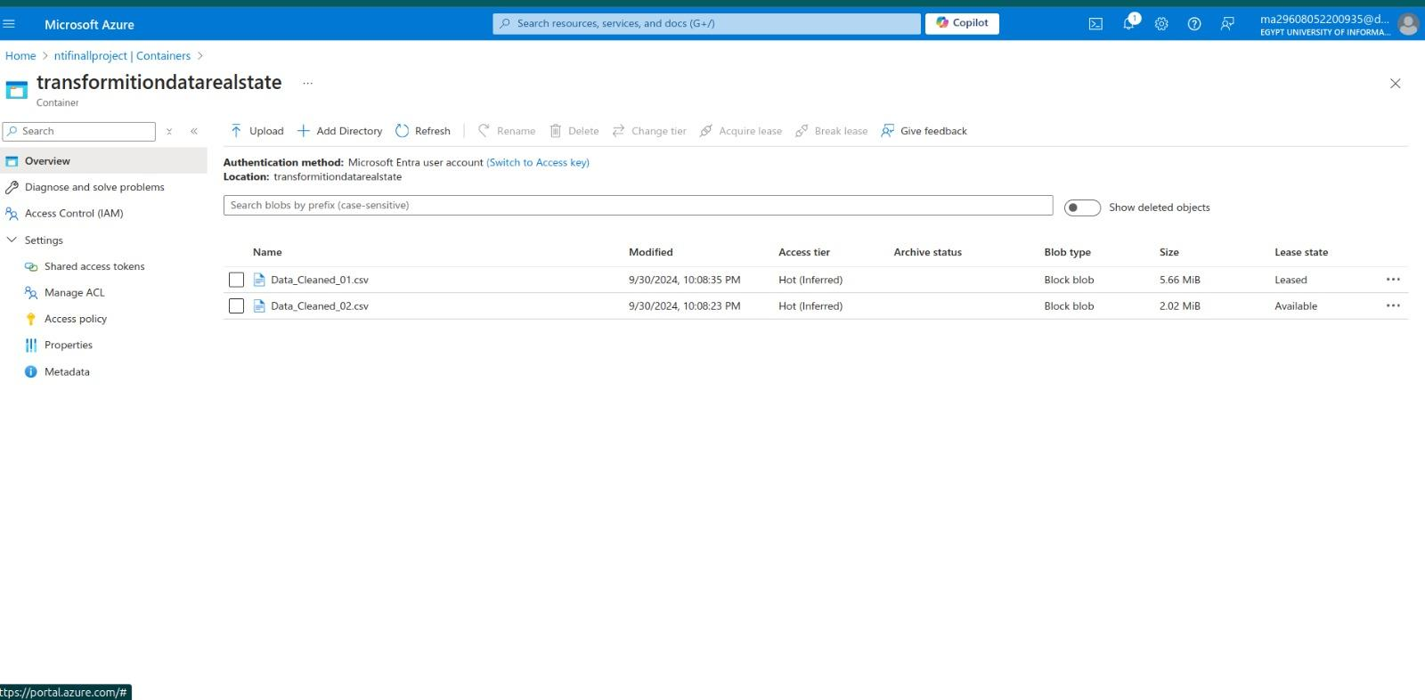

Slide 18
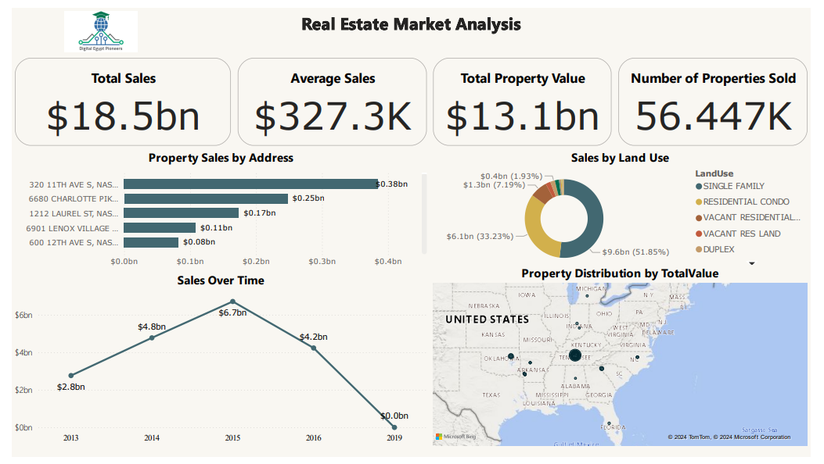

Slide 19
Overall Insights
The real estate market generated significant sales over the past few years but has seen a decline since its peak in 2015.
Single-family homes and residential condos dominate the market, and a small number of high-value properties contribute disproportionately to total sales.
Geographical analysis indicates that certain regions of the U.S. are much more active in terms of property sales.

Slide 20
Recommendations to Improve Business
Target High-Value Locations: Since sales are concentrated in specific areas, the business should focus on these high-performing locations for new developments or investments.
Revive Market Interest: Given the decline in sales post-2015, the business should investigate ways to revive interest, possibly through marketing strategies, flexible financing options, or offering new types of properties that align with current buyer preferences.
Focus on Popular Property Types: Single-family homes and condos are the most sold property types, and future developments should cater to this demand. The business can also explore adding more features or improving these property types to maintain customer interest.
Expand Geographical Reach: Regions where property values are higher should be prioritized for expansion or further market penetration.

Slide 21
Conclusion
The Real Estate Market Analysis project provided valuable insights into the performance of the real estate sector through comprehensive data analysis using modern tools and technologies.
SQL Server was instrumental in creating the database and performing data cleaning, ensuring the dataset was accurate and ready for further processing.
Azure Synapse Spark Pools and data flows were leveraged to transform the data efficiently, connecting GitHub as the source and Azure Storage as the data repository, ensuring smooth integration into Power BI for visualization.
The insights gathered from the data can guide decision-making for property development, marketing strategies, and geographic expansion.
Notes:
The project successfully demonstrated the power of data-driven decision-making in the real estate domain, offering actionable recommendations for improving business performance in a competitive market.

Slide 22
Thank You

